Slide 1
Individual learning accounts and training funds – European perspectives
Joint AK Wien and waff conference: Professional qualification in the tension between structure and individual

Slide 2
Cedefop’s long tradition of work on financing VET/AL
A long-standing Financing VET project
The Financing of Vocational Training in the European Community (1981)
National reports on VET financing during the 1980s
Financing CVET report (1994)
Second wave of national VET financing reports (1998-1999)
Thematic reports on Sectoral training funds (2008) Individual learning accounts (2009) Tax incentives (2009) Cost-sharing schemes in the newer EU MS (2009) Loans (2012) Training leave (2012) Payback clauses (2012)
Governance and financing of apprenticeships (2016) Financing apprenticeships (2020)
Subsidies and other policies to support training provision in MSMEs (2024)
  Cedefop databases on financing adult learning (2020) and apprenticeships (2020)
  Continuing vocational training in enterprises in the EU report based on CVTS data (2026)

Slide 3
Recent/on-going activities
  Study on the potential for ILAs
    Online workshop to present emerging findings in 2024
  Study on training funds in the EU
    Online workshop to present emerging findings in 2024
  ReferNet request on adult learning financing systems (all EU MS + NO & IS)
    Policy developments, update on ILAs, description of public financing structures
    Detailed ILA scheme description (only for selected countries with a clearly defined scheme)
  Conference Financing adult learning: The role of public funding

Slide 4
Cedefop study on individual learning accounts (ILAs)
Objective
Explore the potential for developing ILAs in selected EU Member States and provide support to stakeholders in designing and implementing ILAs
Key activities
Develop analytical framework
Conduct five in-depth case studies - Austria, Estonia, Germany, Ireland, Netherlands - including country-specific scenarios and policy reflections
Formulate general policy guidelines

Slide 5
Defining individual learning account
1990
2000
2010
2020
Individual contributions (‘savings’) are topped up
(e.g. by 50% up to a threshold)
‚Saving accounts‘
(UK 1998/2000-2002, experiments in NL (2001/2) discussed but dismissed in e.g. SE)
A maximum
amount (co-)funding can be used within a set time frame (with or without individual co-funding)
‘Individual budgets’
(e.g. AT 1995)
individual training entitlement
(‘account’, personal budget)
all working-age population
accumulation and transferability
enabling framework
‘Value voucher’
(e.g. AT 1995, DE 2004-, EE …)
A voucher for defined
value of co-funding is
distributed (with a limited number of vouchers per individual, with or without individual co-funding)
‘Service voucher’
(e.g IT 2004-)
A voucher for a specific
(= one course) or a type of service is provided (with vouchers per individual limited)
with or without individual
co-funding
‘Integrated entitlement’ Council Recommendation on ILAs (EU, 2022)
(FR, 2020)

Slide 6
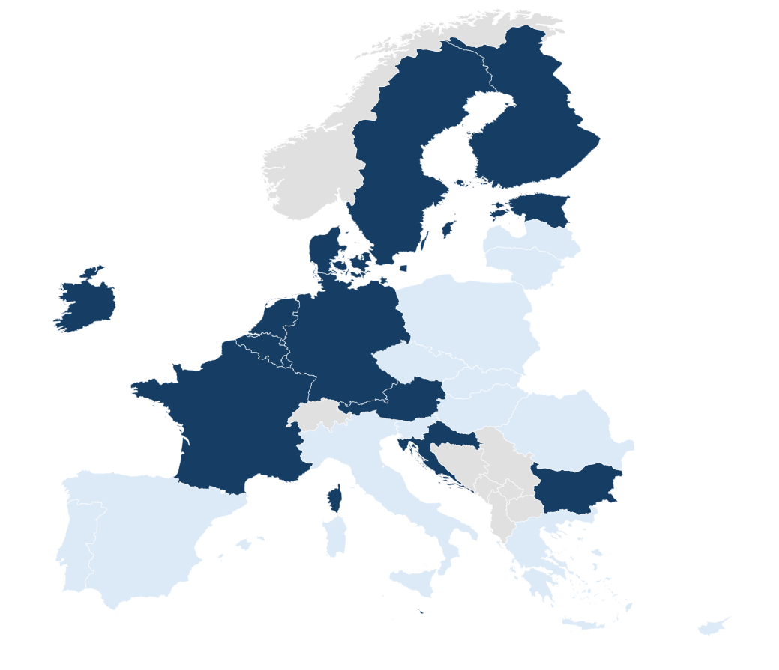
Countries selected for the case studies
EE: ‘Training card’ as recent ILA-relevant instrument within a broad policy mix
NL: ‘STAP-budget’ as a novel
ILA-relevant instrument (2022-2023)
IE: National Training Fund financing variety of policies. Supply-side funding playing important role
AT: national ‘Skilled workers grant’ and regional ‘ILAs’ within AL system dominated by ALMP
DE: Voucher schemes (national, regional) with
AL system under reform

Slide 7
Identifying the space for ILAs: based on the existing financing arrangements
Emerging, ex-post considerations based on individual country reflections
Need to further consider country- and/or region-specific variability
Presence of substantial public financing schemes
Only/primarily supply-side only or both supply- and demand-side schemes
Gaps in coverage of such schemes

Slide 8
Finding the place for ILAs: based on the types of training provision to be supported
Formal education of 6 months+ (often part of initial education)
  High cost; long-term training leave or part-time work arrangements; subsistence costs
Extended intensive non-formal E&T up to 6 months (often provided by PES)
  Average cost, long-term training leave, subsistence costs
Extended non-intensive non-formal E&T, e.g. language courses, modular courses
  Average to low cost, critical to assure continuity over multiple years
Short-duration courses to develop work-relevant skills, e.g. IT, soft skills, driving
  Low cost; large variety; need to ensure relevance and quality; possible overlap with category 5
Job-specific training (mostly employer-provided/sponsored)

Slide 9
Countries with well-established demand-side instruments
 | Space available for ILA | Potential way forward
the Netherlands | Public (co-)financing instrument for the whole working-age population to support participation mainly in short courses (type 3 and 4) | Reform STAP Integrate the budget of STAP into regional LM structures/ vouchers schemes Introduce ILA at national level
Germany | Public (co-)financing instrument for the whole working-age population to support participation mainly in short courses (type 3 and 4) | Reform and expand the Upgrading Training Assistance Implement the proposed federal instruments: - demand-side scheme (direct costs of CVET) - long training leave (subsistence costs) Introduce ‘CVET insurance’
Austria | Public (co-)financing instrument for the whole working-age population to support participation mainly in short courses (type 3 and 4) | Expand supply-side funded framework for AL Introduce national ILA for CVET combined with regional (demand-side) financing instruments Introduce ‘employment insurance’

Slide 10
Countries without extended demand-side instruments
 | Space available for ILA | Potential way forward
Ireland | Less favourable conditions for a new demand-side financing instruments Significant space for scaling-up existing mainly supply-side instruments and strengthening the ‘enabling framework’ | Create a single online portal Scale-up the provision of micro-credentials Establish paid training leave
Estonia | Less favourable conditions for a new demand-side financing instruments (available for some target groups) Significant space for scaling-up existing supply-side instruments and strengthening other areas of AL relevant for ILA | Expand existing financing instruments Strengthen the link between LM needs and public funding for AL Establish quality assurance system for all AL providers
* But with existing substantial supply-side schemes

Slide 11
Cedefop study on training funds
Objective 1
Provide an overview of currently existing training funds across EU-27
Conduct in-depth analysis of operation and performance of training funds in 8 selected EU MS (BE, CY, DK, ES, FR, IE, IT, NL)
Develop country-specific guidelines on how to improve the performance of training funds
Identify conditions for successful development and implementation of training funds and formulate general guidelines for policy-makers, social partners
Objective 2
Explore the potential for establishing new training funds or significantly modernising the existing ones in the EU. Conduct 2 case studies (LV, PL)
Develop country-specific guidelines on how to establish/modernise training funds

Slide 12
Definition and operationalisation of training funds
Institutions aiming at enhancing IVET/CVET in enterprises and mutualising the related costs across enterprises
Employers are mandated (by law or binding collective agreement) to contribute financially (typically via training levy) and are eligible for various forms of support for IVET/CVET
Collected funds are mainly used for the original purpose - closed funding cycle
Business interest organisations – or both social partners - have a key influence on the ways the collected means are used
Individual employees can be mandated to contribute as well, can be among the beneficiaries and their interest organisations can be involved in training fund’s governance
Operationalisation: The study aims at covering only training funds making a substantial contribution to CVET (rated against the backdrop of the available public support for CVET in total)

Slide 13
Basic characteristics of training funds
Complex organisations playing a key role in financing, governance, relevance and quality of training
Highly heterogenous (objectives, governance, money collection and allocation, activities and groups supported)
Typically set at national level (e.g. based on tripartite governance; levy defined by law) or sectoral level (based on collective agreements; bipartite governance; levy defined by sector)
Specific solutions in particular countries, e.g. inter-professional funds for CVT in Italy (may be linked to particular sub-field of the economy, profession or size of the company; run by social partners; levy set at national level)
Sources of funding: company levy (mainly): EU funding, government subsidies financed from general taxation, bank interest…
Forms of support: financial support to companies, training providers and also individuals; direct training provision (using own facilities), non-financial and system services (HR advice, LM/skill needs analysis, qualification tools, QA…)

Slide 14

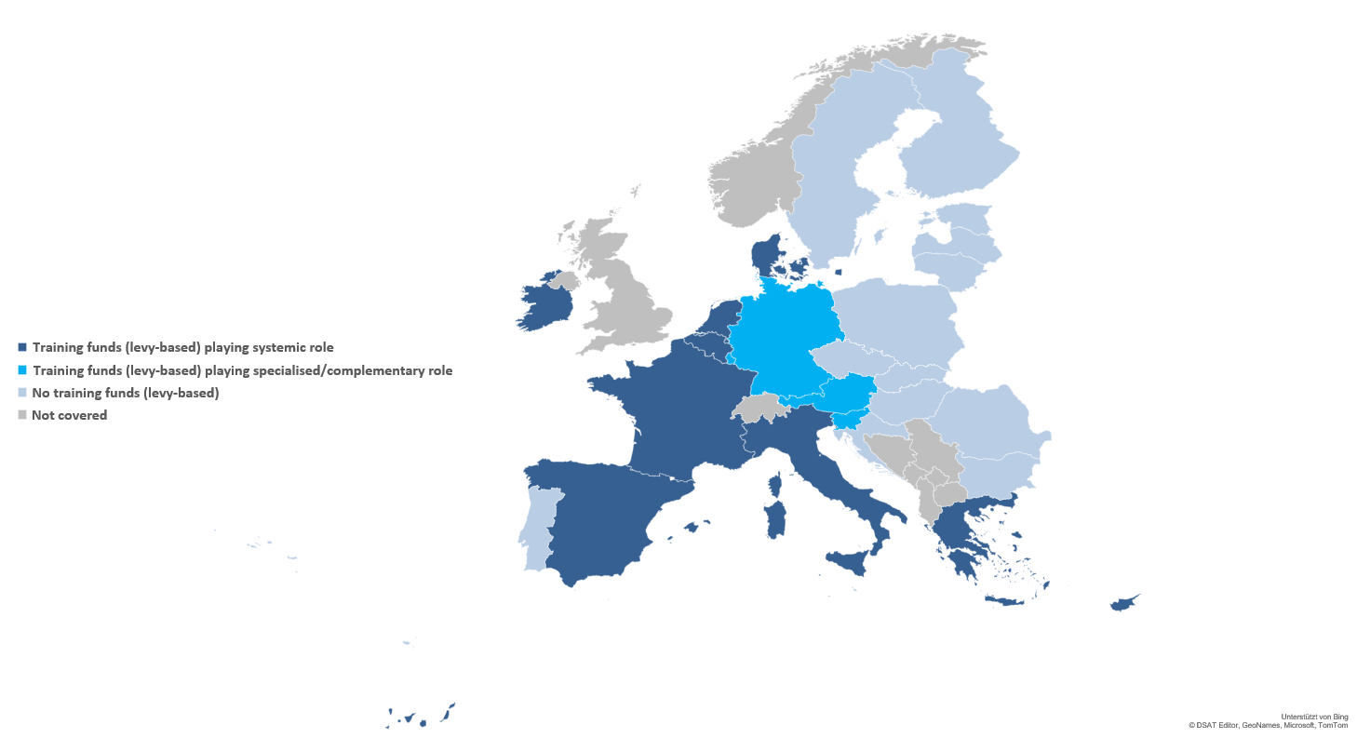
Diffusion of training funds across the EU
(by June 2023)

Slide 15
Training funds can play an important role in CVET systems and support skills development systems
Key contributions of training funds:
Secure funding: Provide sustainable CVET financing through employer levies and public sources
Better alignment: Link training supply with employer skill needs and improve quality
Incentivise participation: Lower costs and promote skill development and sectoral mobility
Enhance equity: Target employers and individuals to widen CVET access
Act as knowledge hubs: Support employers and providers, steering system development and learning culture
Ensure continuity: Independent governance safeguards funding stability beyond policy cycles, boosting productivity, growth, and lifelong learning

Slide 17
Annex I: Designing and implementing ILAs – step by step
1. Conduct preparatory work
- Stock-taking of adult learning system
- Forecasting funding
2. Identify the space for intervention ILA within the existing system
- Are there similar schemes already existing
- To what extent the existing schemes cover both short and long courses?
- Are there any gaps in the coverage (e.g. specific target groups)
- Are the existing mostly demand-side or supply-side?
- How would a new ILA scheme interact with the existing schemes?

Slide 18
Designing and implementing ILAs – step by step
3. Design the instrument
Fully-fledged, full-scale ILA in line with the Council Recommendation
- Range of the group entitled
- Size of annual entitlement
- Potential mandatory (minimal) individual contribution
- Preferential treatment for specific target groups
- Accumulation of the entitlement
- Range of eligible learning opportunities
- Costs for administrative controls and decision making
Smaller, complementary ILA-type instruments
- e.g. limited budget instead of an entitlement, no accumulation but higher levels of support
for particular learning opportunities, specific groups, etc
- initial piloting designs as the basis for working towards fully-fledged ILA
Expanding the current financing instruments

Slide 19
Designing and implementing ILAs – step by step
4. Strengthen training leave and support for subsistence costs
short-term training leave where employees continue receiving their wages; public contributions to employer’s wage costs
unpaid long-term educational leave and receiving income replacement/ contribution to living costs
5. Reinforce other elements of the enabling framework
6. Close other key gaps in adult learning system
7. Negotiate a policy package; develop multi-year implementation plan
8. Create governance structures
9. Set up continuous monitoring
10. Review with stakeholders

Slide 20
Annex II: Introducing and designing a levy-based training fund
Identify the potential for a training fund
    Conduct a stock-taking exercise to assess current CVET provision
    Identify the barriers that hinder training provision (e.g. insufficient funding)
    Evaluate how training fund could address these barriers
    Engage social partners and other relevant stakeholders
Select the legal mechanism for introducing a levy
    Dedicated national law
    Using existing funding streams (e.g. social security contributions)
    Collective agreements
Design the training fund
    Determine the levy rate
    Decide on the scope of the activities supported
    Build mechanism to ensure stable funding through economic cycles
    Include support mechanisms for employers and employees

Slide 21
Introducing and designing a levy-based training fund
Support interest mediation and interest aggregation
    Establish governance structures that involve employers’ and employees' representatives in decision-making
    Seek mechanisms which facilitate collective agreements on CVET relevant issues
    Support interest aggregation with regards to CVET
    Ensure development of high-quality training by leveraging training fund’s influence and working with public and other relevant stakeholders
Ensure coordination of training fund and other key institutions of skill formation/adult learning system
    Integrate training fund with existing policy frameworks
    Establish coordination mechanisms to avoid competition between (sectoral) training fund and other institutions

